Slide 1
Chapter Two Intelligent Agent
Objective:
Define what an agent is in general
Rationality
Gives ideas about agent, agent function, agent program and architecture, environment, percept, sensor, actuator (effectors),
Gives idea on how agent should act
How to measure agent success
Rational agent, autonomous agent and Omniscience agent
Types of environment
Types of agent

Slide 2
Why agent center approach?
In the past, success in AI research was limited.
Problem being ill-defined .
Researchers were trying to provide answers for which they did not know the questions.
For e.g. they want to develop an AI system that can “solve problems in an intelligent way”.
But what type of “problem”, and what is meant by “intelligent” were not clearly stated.
The agent-centred approach to AI attempts to overcome these limitations.
It strictly defining the environment in which an intelligent agent is expected to operate, and the type of behaviour that is expected.

Slide 3
What is an agent?
Is any thing that can be viewed as perceiving its environment through sensors and acting upon the environment through the effectors.
Human as an agent has eyes, ears, and other organs for sensors; and hands, legs, mouth, and other organs as effectors.
Robots as an agent has camera, sound recorder, infrared range finder for sensors; and various motors for effectors.

Slide 4
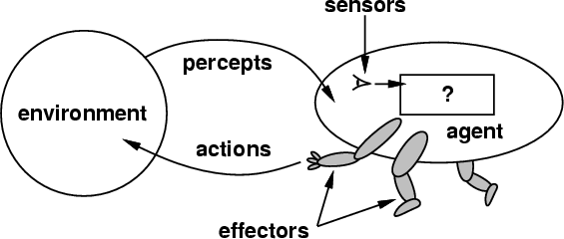
How do you design an intelligent agent?
An intelligent agent perceives its environment via sensors and acts rationally upon that environment with its effectors.
A discrete agent receives percepts one at a time, and maps this percept sequence to a sequence of discrete actions.
Properties
Reactive to the environment
Pro-active or goal-directed
Interacts with other agents through communication or via the environment
Autonomous

Slide 5

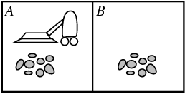
Component of Agents
Any agent consists of two parts:
Agent architecture
Agent program
The architecture is the hardware and the program is the software.
The role of the agent program is to implement the agent function.
The agent function is a mapping from percept histories to actions.
Ideal Example of Agent :- Vacuum-cleaner world
Percepts: location and contents
e.g., [A, Dirty]
Actions: Left, Right, Suck dirt's

Slide 6
How should Agents act?
Agents may be rational or human like
We have seen how human act or think is difficult to understand since due to the complex structure of human intelligence.
Our agent should be designed from rationality view that act rationally
A rational agent is an agent that does the right thing for the perceived data from the environment
What is right is an ambiguous concept but we can consider the right thing as the one that makes the agent more successful.
Success is also measured by using performance measure.
Question: how and when do you measure success in performance?

Slide 7
Performance measure (how?)
Subjective measure using the agent
How happy is the agent at the end of the action
Agent should answer based on his opinion
Some agents are unable to answer, some are delude them selves, some over estimate and some under estimate their success
Therefore, subjective measure is not a better way.
Objective Measure imposed by some authority is an alternative

Slide 8
Performance measure (how?)
Objective Measure
Needs standard to measure success
Provides quantitative value of success measure of agent
Involves factors that affect performance and weight to each factors
E.g., performance measure of a vacuum-cleaner agent could be
amount of dirt cleaned up,
amount of time taken,
amount of electricity consumed,
amount of noise generated, etc.
The time to measure performance is also important for success. It may include knowing starting time, finishing time, duration of job, etc

Slide 9
Omniscience versus Rational Agent
Omniscience agent is distinct from Rational agent
An omniscient agent knows the actual outcome of its actions and can act accordingly.
Is impossible in reality; it is an ideal agent in real world
Omniscient agent that act and think rationally never make a mistake.
Agents can perform actions in order to modify future percepts so as to obtain useful information (information gathering, exploration)
However, rational agent is an agent that tries to achieve more success from its decision.
Rational agent could make a mistake because of unpredictable factors at the time of making decision.
For each possible percept sequence, a rational agent should select an action that is expected to maximise its performance.

Slide 10
Factors to measure rationality of agents
Percept sequence perceived so far (do we have the entire history of how the world evolve or not)
The set of actions that the agent can perform (agents designed to do the same job with different action set will have different performance)
Performance measures ( is it subjective or objective? What are the factors and their weights)
The agent knowledge about the environment (what kind of sensor does the agent have? Does the agent knows every thing about the environment or not)

Slide 11
Ideal rational Agent
For each possible percept sequence, an ideal rational agent should do what every action is expected to maximize its performance measure, on the basis of the evidence provided by the percept sequence and what ever built-in knowledge the agent has.
Ideal rational agent implementation require perfection
In real situation such agent is difficult to achieve
Why car accident happened? Because drivers are not perfect agent

Slide 12
Autonomy
An agent is autonomous if its behavior is determined by its own experience (with ability to learn and adapt)
Agent that lacks autonomous, if its actions are based completely on built-in knowledge.
Example: student grade decider agent:
Knowledge base given: rules for converting numeric grade to letter grade
Case 1: agent always follows the rule (lacks autonomous)
Case 2: agent that modify the rules by learning exceptions from the knowledge base as well as grade distribution.

Slide 13
Structure of Intelligent Agent
Structure of AI Agent refers to the design of intelligent agent program (function that implement agent mapping from percept to actions) that will run on some sort of computing device called architecture.
This course focus on intelligent agent program function theory, design and implementation.
Design of intelligent agent needs prior knowledge of
Performance measure or Goal the agent supposed to achieve,
On what kind of Environment it operates
What kind of Actuators it has (what are the possible Actions),
What kind of Sensors the agent has (what are the possible Percepts)
Performance measure → Environment → Actuators → Sensors are abbreviated as PEAS.
Percepts→ Actions→ Goal → Environment are abbreviated as PAGE

Slide 14
Examples of agents structure and sample PEAS
Agent: automated taxi driver:
Environment: Roads, traffic, pedestrians, customers
Sensors: Cameras, sonar, speedometer, GPS, odometer, engine sensors, keyboard
Actuators: Steering wheel, accelerator, brake, signal, horn
Performance measure: Safe, fast, legal, comfortable trip, maximize profits
Agent: Medical diagnosis system
Environment: Patient, hospital, physician, nurses, …
Sensors: Keyboard (percept can be symptoms, findings, patient's answers)
Actuators: Screen display (action can be questions, tests, diagnoses, treatments, referrals)
Performance measure: Healthy patient, minimize costs, lawsuits

Slide 15
Examples of agents structure and sample PEAS
Agent: Interactive English tutor
Environment: Set of students
Sensors: Keyboard (typed words)
Actuators: Screen display (exercises, suggestions, corrections)
Performance measure: Maximize student's score on test
Agent: Satellite image analysis system
Environment: Images from orbiting
Sensors: Pixels of varying intensity, color
Actuators: print categorization of scene
Performance measure: Correct categorization

Slide 16
Examples of agents structure and sample PEAS
Agent: Part picking robot
Environment: Conveyor belt with parts
Sensors: pixels of varying intensity
Actuators: pickup parts and sort into bins
Performance measure: place parts in correct bins

Slide 17
Agent programs
An agent is completely specified by the agent function that maps percept sequences into actions
Aim: find a way to implement the rational agent function concisely
Skeleton of the Agent
FUNCTION SKELETON-AGENT (percept) returns action
static memory, the agent’s memory of the world
memory← UPDATE-MEMORY (memory, percept)
action ← CHOOSE-BEST-ACTION (memory)
memory← UPDATE-MEMORY (memory, action)
RETURN action
Note:
1. the function gets only a single percept at a time
Q: how to get the percept sequence?
2. The goal or performance measure is not part of the skeleton

Slide 18
Table-lookup agent
Table look up agent store all the percept sequences –action pair into the table
For each percept, this type of agent will search for the percept entry and return the corresponding actions.
Table look up couldn’t be the right option to implement successful agent
Why?
Drawbacks:
Huge table
Take a long time to build the table
No autonomy
Even with learning, need a long time to learn the table entries

Slide 19
Agent types
Based on memory of the agent, and they way the agent takes action we can divide agents into five basic types:
These are (according to their increasing order of generality) :
Simple reflex agents
Model-based reflex agents
Goal-based agents
Utility-based agents
Learning agent
Each will be discussed as follows .
Notation of model:
Rectangles: used to represent the current internal state of the agent decision process
Ovals: used to represent the background information used in the process

Slide 20
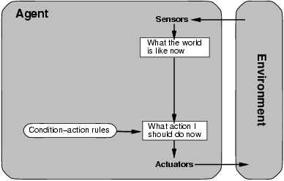
Simple Reflex Agents
It is the simplest type of Agent and It use a set of condition-action rules.
They take action based solely on the current percept, without considering the history or future consequences.
The rules are of the form “if this is the percept then this is the best action”.
They cannot make decisions on things that they cannot directly perceive, i.e. they have no model of the state of the world.

Slide 21
Simple reflex agent function prototype
Function SIMPLE_REFLEX_AGENT(percept) return action
static : rules, a set of condition –action-rule
state←INTERPRET-INPUT(percept)
rule←RULE-MATCH(state, rules)
Action←RULE-ACTION[rule]
Return action
Some real examples of simple reflex agents:
Automatic Door Sensor
Automatic Faucets: In many public restrooms, automatic faucets are used to conserve water and maintain hygiene
Automatic hand sanitizer dispensers

Slide 22
Model Based Agent
It is a more complex type of Agent.
Model-based reflex agents have an internal model or representation of the world.
They maintain an internal state that captures information about the current state of the world and use it to make decisions.
Model based agents maintain an internal model of the world, which is updated by percepts as they are received.
In addition, they have built-in knowledge (i.e. prior knowledge) of how the world tends to evolve.
These agents can consider past percepts and actions to choose appropriate actions based on the current state.
They live in the present only and do not think about the future.

Slide 23
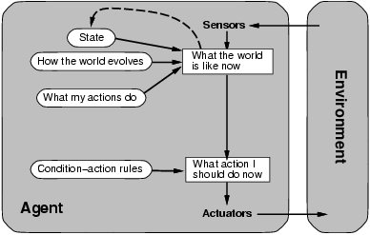
Model Based Agent

Slide 24
Model-based reflex agents
Function MODEL_BASED_AGENT(PERCEPT) return action
static state, a description of the current world state
rules, a set of condition action rules
state←UPDATE_STATE(state, percept)
rule←RULE_MATCH(state, rues)
action←RULE_ACTION[rule]
state←UPDATE_STATE(state,action)
return action
Here are a few real-life examples of model-based reflex agents:
Autonomous Driving Systems
Chess Playing Programs
Virtual Assistants

Slide 25
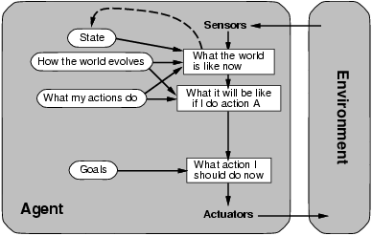
Goal-based agents
Goal-based agents have not only an internal model of the world but also a goal or objective to achieve.
They consider their current state, internal model, and the desired goal when making decisions.
These agents use planning and reasoning techniques to determine a sequence of actions that will lead them closer to the desired goal.

Slide 26
Goal-based agents
Function GOAL_BASED_AGENT(PERCEPT) return action
static state, a description of the current world state
goal, a description of the goal to achieve may be in terms of state
state←UPDATE_STATE(state, percept)
actionSet←POSSIBLE_ACTIONS(state)
action←ACTION_THAT_LEADS_TO_GOAL(actionSet) state←UPDATE_STATE(state,action)
return action
Here are a few real-life examples of goal-based agents:
Route Planning Systems
Project Management Software
Financial Planning Tools

Slide 27
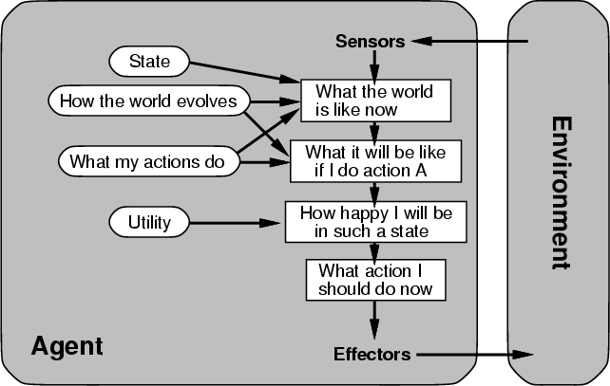
Utility Based Agents
Goal can be useful, but are sometimes too simplistic.
Clearly there can be many actions that lead to a goal being achieved, but some are better than others.
Utility based agents deal with this by assigning a utility to each state of the world.
Utility-based agents make decisions by considering not only goals but also the associated utilities or values(desirability or importance of different outcomes)
They assign a value or utility to different states or outcomes and choose actions that maximize their expected utility.

Slide 28
Utility-based agents
Function UTILITY_BASED_AGENT(PERCEPT) return action
static state, a description of the current world state
goal, a description of the goal to achieve may be in terms of state
state←UPDATE_STATE(state, percept)
actionSet←POSSIBLE_ACTIONS(state)
action←BEST_ACTION(actionSet)
state←UPDATE_STATE(state,action)
return action
Here are a few real-life examples of utility-based agents:
Autonomous Trading Systems
Energy Management Systems
Travel Planning Tools:

Slide 29
Learning Agents
A learning agent in AI is the type of agent which can learn from its past experiences, or it has learning capabilities.
It starts to act with basic knowledge and then able to act and adapt automatically through learning.
They can acquire knowledge, modify their internal model, and adjust their decision-making process based on feedback and interactions with the environment.
Learning agents use techniques such as reinforcement learning, supervised learning, or unsupervised learning to adapt and improve their performance.
Learning Element
It is responsible for making improvements by learning from environment.
The input to the learning element comes from the Critic.

Slide 30
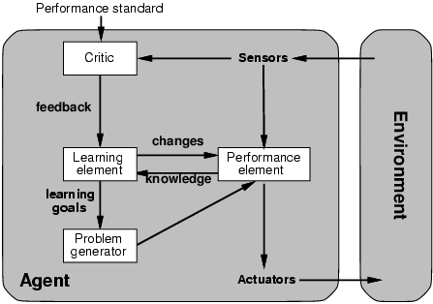
Learning Agents
Critic
Analyses incoming percepts and decides if the actions of the agent have been good or not.
To decide this it will use an external performance standard.
Problem Generator
Responsible for suggesting actions that will result in new knowledge about the world being acquired.

Slide 31
Types of Environment
Based on the portion of the environment observable
Fully observable
The agent has access to complete and accurate information about the current state of the environment at any given time.
The agent can directly perceive or observe the entire state of the environment and make decisions accordingly.
Examples:-chess or board games
Partially observable
The agent does not have access to the complete state of the environment
The agent receives incomplete or noisy observations or percepts, which may not provide a complete picture of the environment's state.
Examples:- card games
Fully unobservable

Slide 32
Types of Environment
Based on the effect of the agent action
Deterministic
The effect of the agent's actions on the environment is fully predictable and consistent.
The next state of the environment is completely determined by the current state and the action executed by the agent.
Examples:- puzzle-solving tasks or simple physics simulations
Strategic
If the environment is deterministic except for the actions of other agents, then the environment is strategic
Stochastic or probabilistic
The agent's actions may have varying outcomes, and the agent needs to consider probabilities and uncertainties when making decisions
is random in nature which is not unique and cannot be completely determined by the agent.

Slide 33
Types of Environment
Based on the number agent involved
Single agent
A single agent operating by itself in an environment.
Multi-agent
multiple agents are involved in the environment
Based on the state, action and percept space pattern
Discrete
A limited number of distinct, clearly defined state, percepts and actions.
Continuous
state, percept and action are consciously changing variables
Note: one or more of them can be discrete or continuous

Slide 34
Types of Environment cont …
Based on the effect of time
Static: The environment is unchanged while an agent is deliberating.
Dynamic: The environment changes while an agent is not deliberating.
semi-dynamic: The environment is semi-dynamic if the environment itself does not change with the passage of time but the agent's performance score does
Based on loosely dependent sub-objectives
Episodic: The agent's experience is divided into atomic "episodes" (each episode consists of the agent perceiving and then performing a single action), and the choice of action in each episode depends only on the episode itself.
Sequential: The agent's experience is a single atomic "episodes"

Slide 35
Environment types example (assignment)
 | Chess with a clock | Chess without a clock | Taxi driving
Fully observable | ? | ? | ?
Strategic | ? | ? | ?
Episodic | ? | ? | ?
Static | ? | ? | ?
Discrete | ? | ? | ?
Single agent | ? | ? | ?
Dynamic | ? | ? | ?
The environment type largely determines the agent design
The real world is (of course) partially observable, stochastic, sequential, dynamic, continuous, multi-agent

Slide 36
Summary
An agent perceives and acts in an environment, has an architecture, and is implemented by an agent program
An ideal agent always chooses the action which maximizes its expected performance, given its percept sequence so far
An autonomous agent uses its own experience rather than built-in knowledge of the environment by the designer
An agent program maps from percept to action and updates its internal state
Reflex agents respond immediately to percepts
Goal-based agents act in order to achieve their goal(s)
Utility-based agents maximize their own utility function
Representing knowledge is important for successful agent design
The most challenging environments are partially observable, stochastic, sequential, dynamic, and continuous, and contain multiple intelligent agents.

